Slide 1
SmartGist - AI Powered Multi Summarizer
Ch Bhavani Shankar – N200561

Slide 2
Abstract
SmartGist is a multimodal AI summarizer that intelligently condenses content from various input sources such as text files, PDFs, audio, YouTube videos, research papers, web pages, and Wikipedia. Leveraging LangChain, Google Generative AI, and Streamlit, it automates summarization using a refined LLM-driven pipeline. This tool enhances productivity and knowledge consumption with wide applicability in research, education, and content management.

Slide 3
INTRODUCTION
i. Motivation for the Work
Growing information overload from diverse formats (text, video, audio, web).
Manual summarization is time-consuming and inconsistent.
Need for a unified, AI-powered tool for rapid and high-quality summaries.
ii. Real-world Applications
Assisting researchers and students in literature reviews.
Enhancing productivity for professionals handling large documents.
Auto-summarizing meetings, lectures, and webinars.

Slide 4
Related Works / Existing Works
Tool | Input Support | Limitation
SMMRY | Text-only | No multimedia
Scholarcy | PDFs & articles | Limited free usage
Otter.ai | Audio transcripts | No document/web support
ii. Research Gaps Identified
Lack of unified summarization across modalities.
Limited control over summarization style and depth.
Scarce open-source tools with full flexibility.

Slide 5
Proposed Method
i.FlowChart :
User Input →
├── Text / PDF Loader
├── Audio Loader (AssemblyAI)
├── YouTube Transcript API
├── Web Scraper
├── ArXiv Paper Loader
└── Wikipedia Loader
↓
Document Processing (Recursive Chunking)
↓
Summarization Chain (LLM + LangChain Refine)
↓
Summary Output

Slide 6
Proposed Method (contd.)
ii. Explanation of Flowchart Components
Input Handling: Streamlit chat_input accepts text and multiple file formats.
Document Loaders: Handles each type using appropriate LangChain loaders.
Chunking: Uses RecursiveCharacterTextSplitter for manageable input to LLMs
Summarization: Uses refine chain method with GoogleGenerativeAI model
UI Output: Displays output summary interactively in Streamlit.
iii. Algorithm (Pseudo Code)
Input = user_uploaded_file or URL
if type == PDF:
loader = PyPDFLoader
elif type == Audio:
loader = AssemblyAIAudioTranscriptLoader
...
docs = loader.load_and_split()
chunks = RecursiveCharacterTextSplitter.split_documents(docs)
summary = load_summarize_chain(llm, chain_type="refine").run(chunks)
display(summary)

Slide 7
Experimental Setup
ii. Datasets
i. Technologies/Libraries Used
LangChain, Streamlit, GoogleGenerativeAI
Document loaders: PDF, Audio, Web, YouTube, Arxiv, Wikipedia
AssemblyAI API, YouTubeTranscript API ​
No fixed datasets; accepts real-world inputs from users via file/URL.
iii. System Hardware
Laptop: HP Victus
GPU: NVIDIA GeForce RTX 2050
RAM: 16 GB

Slide 8
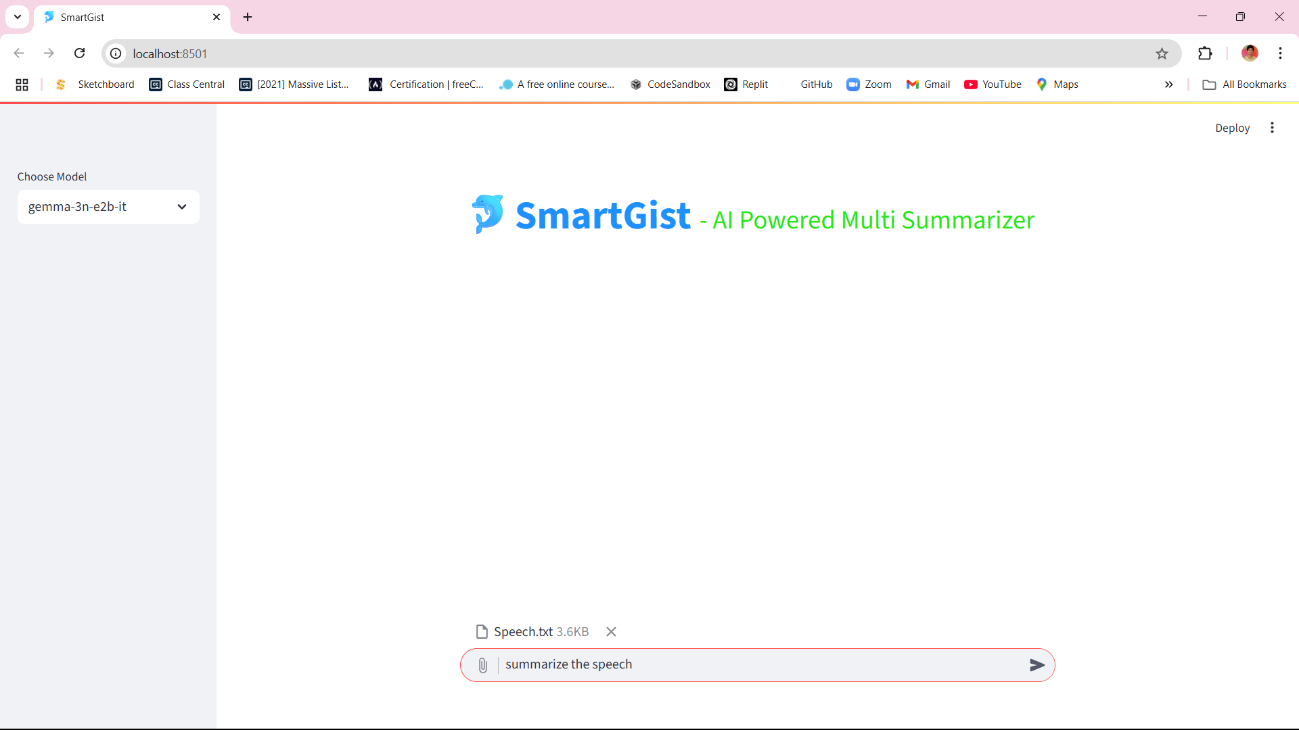

Slide 9
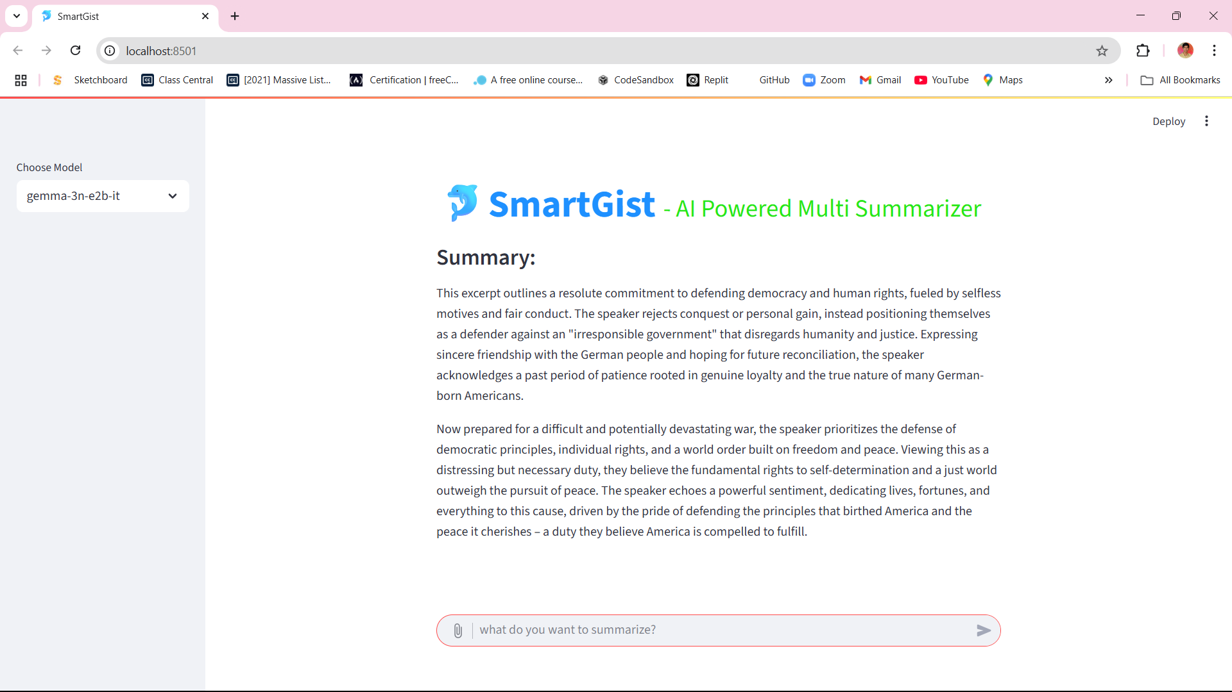

Slide 10
Conclusions
SmartGist provides a generalized summarization platform for
all common document types.
Integrating LangChain and Google GenAI ensured scalability and simplicity.
Open-source and user-friendly UI via Streamlit for real-time usage.

Slide 11
Future Scope
Add support for multi-language summarization.
Integration with HuggingFace Transformers for offline models.
Customize summary length, tone, and structure.
Mobile App/Browser Extension for quick access.

Slide 12
References
Krish Naik: “Complete Generative AI Course with Langchain and Huggingface”,
54 hours
LangChain Documentation: https://docs.langchain.com
Google Generative AI API: https://ai.google.dev
Streamlit Docs: https://docs.streamlit.io
AssemblyAI API: https://www.assemblyai.com
YouTubeTranscript API & LangChain loaders

Slide 13
THANK YOU
Ch Bhavani Shankar
N200561​
n200561@rguktn.ac.in

